Slide 1

CEF440 – Group 5
Design and Implementation of a Mobile App for Collection of User Experience Data
Requirements Gathering and Analysis

Slide 2
Introduction
Current Quality of Service (QoS) monitoring systems rely primarily on technical metrics, creating a significant gap: they lack real user experience data. This project aims to develop a mobile application for collecting Quality of Experience (QoE) data directly from mobile network subscribers in Cameroon. By capturing subjective feedback alongside objective measurements, the app will provide network operators with complementary insights into actual user satisfaction, enabling more informed decisions for network optimization and service improvement.
2
University of Buea
CEF440 – Group 5

Slide 3
Stakeholder Identification
Who are we asking?
Primary Users: Mobile subscribers (MTN, Orange, Nexttel) across various regions in Cameroon.
Secondary Stakeholders: Network Engineers (for QoS validation) and App Developers.
The Goal: To capture the "Human Perspective" (QoE) to complement "Technical Data" (QoS).
3
University of Buea
CEF440 – Group 5

Slide 4

The Rationale (Why a Questionnaire?)
Foundation for Success: Why We Ask Before We Build
Converting Subjective to Objective
Translating vague user complaints ("The network is bad") into measurable technical requirements (Latency, Jitter, Signal dBm).
Cultural & Regional Optimization
Ensuring the solution accounts for specific local factors Like behaviors
3
University of Buea
CEF440 – Group 5

Slide 5
The Rationale (Why a Questionnaire?)
Foundation for Success: Why We Ask Before We Build
Eliminating Assumptions
To replace "I think users want..." with "Evidence proves users need..."
Defining Technical Constraints
Setting strict "Performance Budgets" for battery drain and data usage based on real user tolerance.
Risk Mitigation (Avoiding Scope Creep)
Establishing a clear "contract" of what the project will do and what it won't—to prevent wasted development time.
3
University of Buea
CEF440 – Group 5

Slide 6
Requirements Gathering
17
CEF440 Group 5 - University of Buea
GitHub: github.com/BrayanMorningstar237/CEF440_Group5

Slide 7
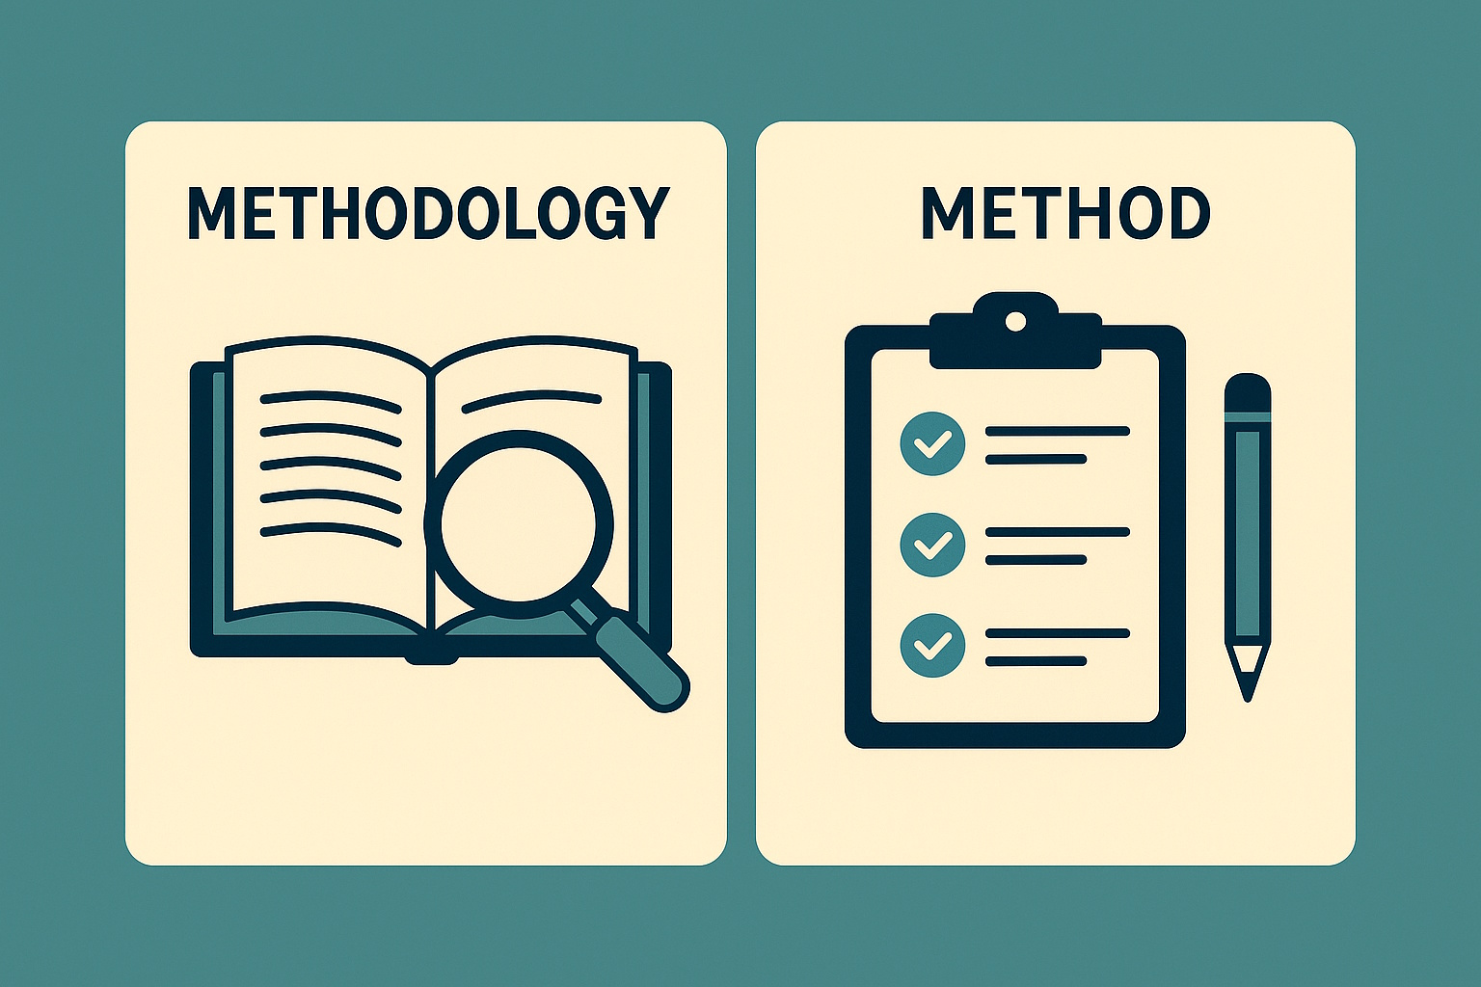
Methodology
Our research employed a structured questionnaire targeting mobile network subscribers in Cameroon. The survey captured comprehensive data across five key dimensions:
Device characteristics
Network usage patterns
Interaction preferences,
Privacy concerns
Adoption willingness.
3
University of Buea
CEF440 – Group 5

Slide 8
Methodology
With over 50+ responses collected, we applied descriptive statistics to analyze user behaviors and requirements. This data-driven approach informed the app's feature prioritization and technical architecture decisions.
3
University of Buea
CEF440 – Group 5

Slide 9

Requirements Gathering
& Analysis
GitHub: github.com/BrayanMorningstar237/CEF440_Group5
17
CEF440 Group 5 - University of Buea

Slide 10
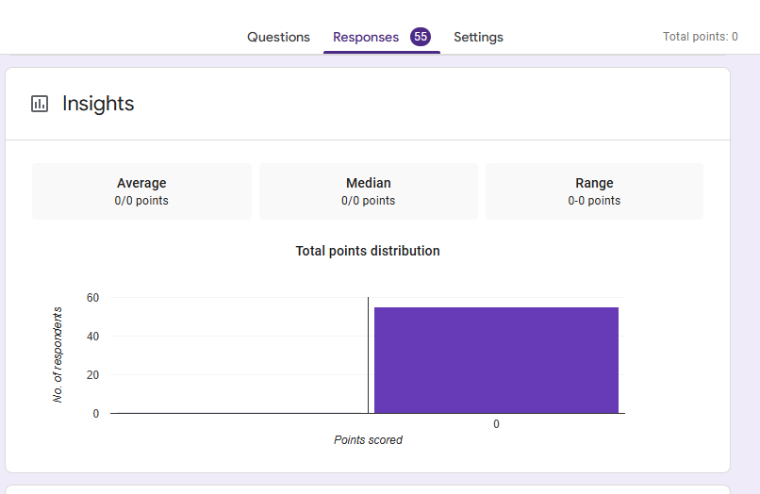
Total Responses
50+
GitHub: github.com/BrayanMorningstar237/CEF440_Group5
17
CEF440 Group 5 - University of Buea

Slide 11
User Technical Environment
4
University of Buea
CEF440 – Internet and Mobile Programming

Slide 12
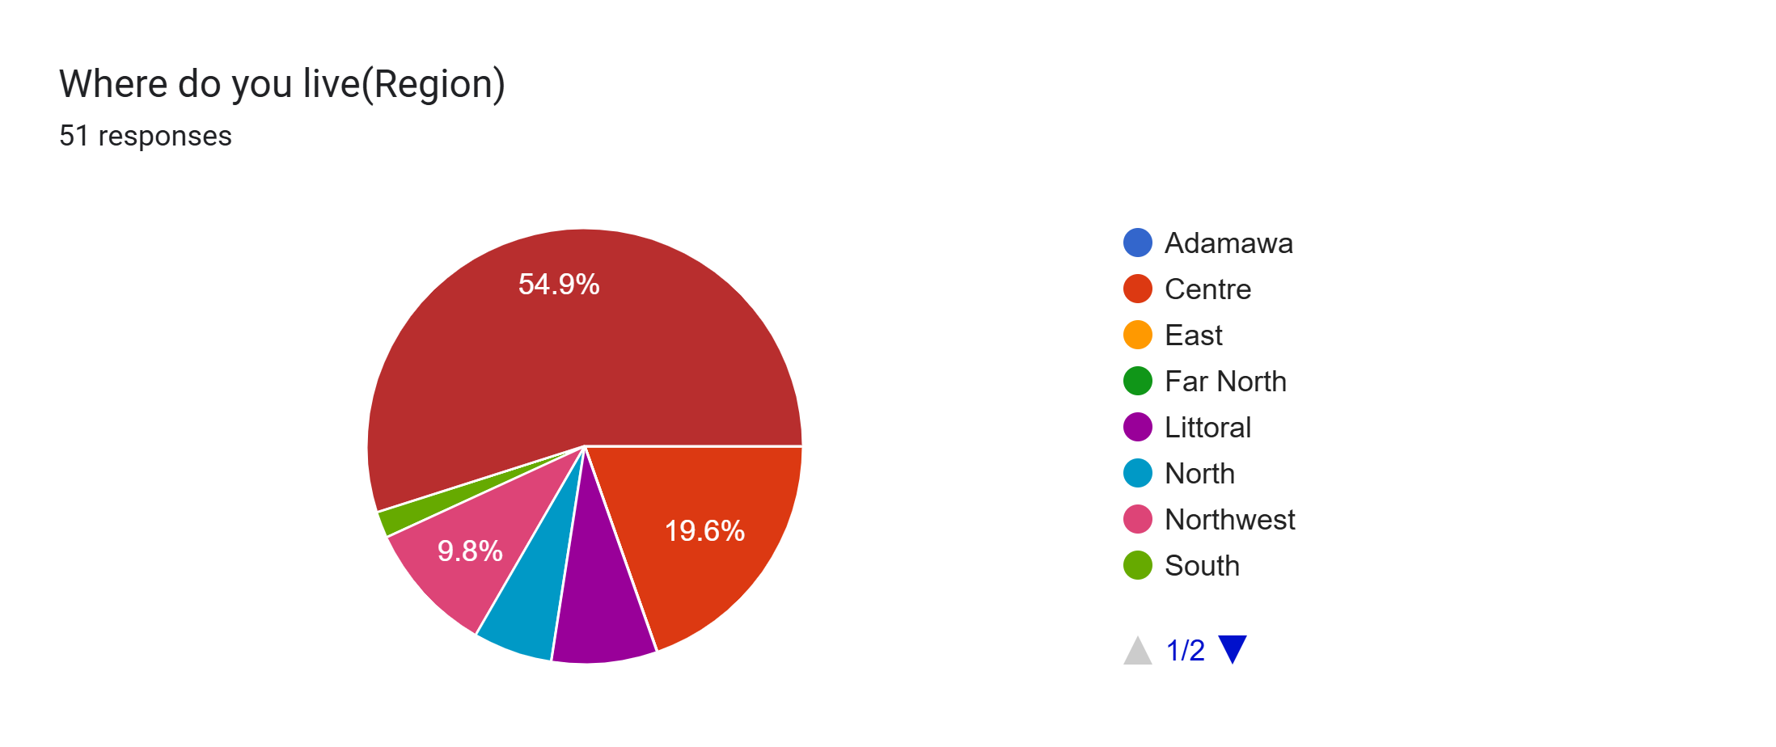
Question
Analysis
Language & Accessibility
Identifying if the respondent is in a predominantly Francophone or Anglophone region to ensure UI localization.
Regional Performance Variance
Network infrastructure in Douala/Yaoundé (Urban) behaves differently than in North/East regions (Rural).
17
CEF440 Group 5 - University of Buea

Slide 13
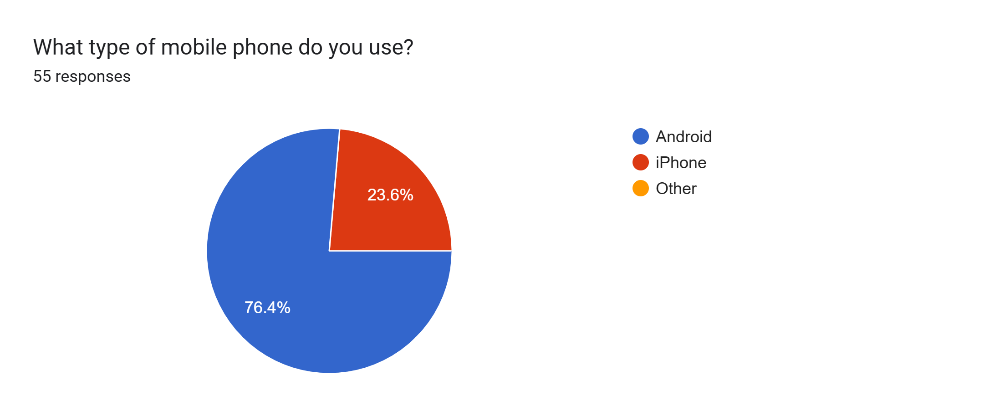
Question
Analysis
Platform Scoping: Identifies whether to prioritize Android or iOS development based on majority stakeholder usage.
Hardware Constraints: Defines the RAM and Processor limits to ensure the app remains lightweight and doesn't cause system lag.
17
CEF440 Group 5 - University of Buea

Slide 14
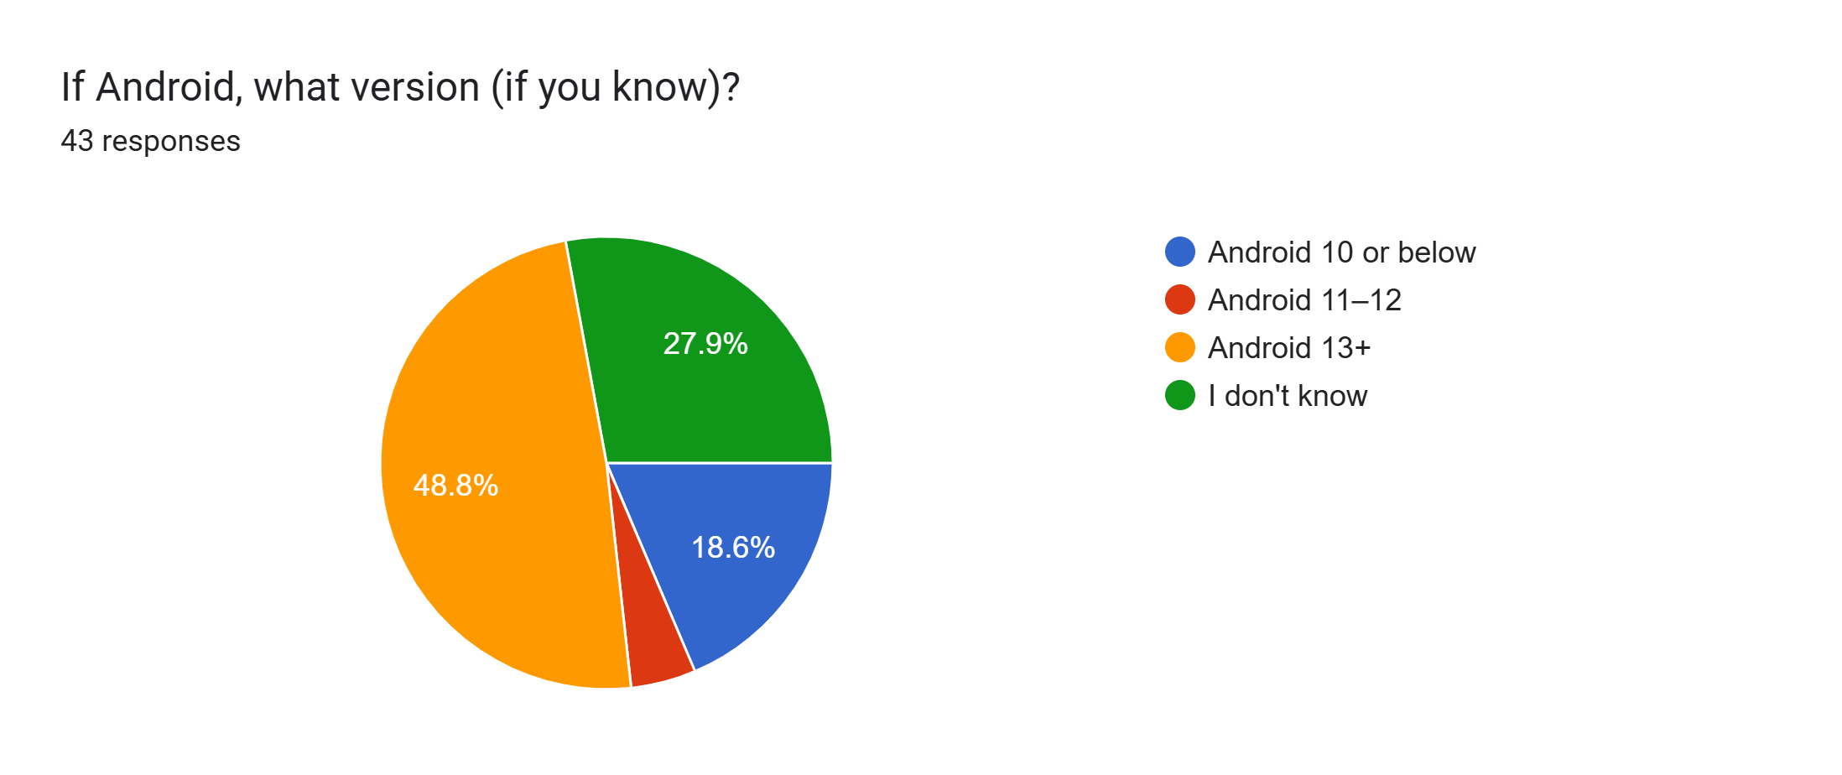
Question
Analysis
Platform Scoping: Identifies whether to prioritize Android or iOS development based on majority stakeholder usage.
Version Support: Determines the Minimum SDK level required to ensure the app works on older devices common in the local market.
Hardware Constraints: Defines the RAM and Processor limits to ensure the app remains lightweight and doesn't cause system lag.
17
CEF440 Group 5 - University of Buea

Slide 15
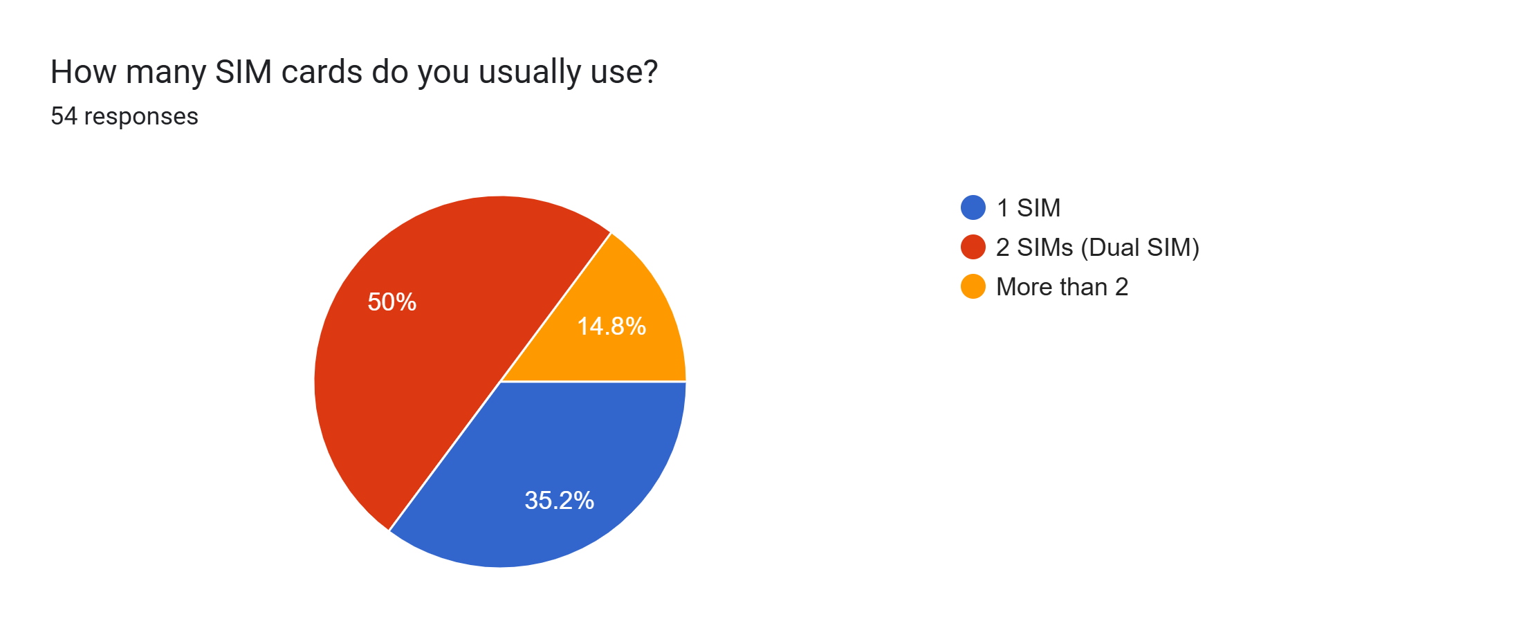
Question
Analysis
Multi-Network Logic: Determines if the app must support simultaneous data tracking for multiple network providers (MTN, Orange, etc.).
API Complexity: Defines the need for Dual-SIM APIs to distinguish between which slot is providing the active data connection.
User Behavior Mapping: Identifies "network hopping" habits where users switch SIMs based on signal strength or data costs.
17
CEF440 Group 5 - University of Buea

Slide 16
User Technical Environment
76.4% of respondents use Android smartphones, with 50% running Android 13 or newer. A notable minority use iOS devices, establishing a clear requirement for cross-platform app development to ensure broad accessibility.
Significant dual-SIM usage was identified among subscribers. This presents a critical technical requirement: the app must accurately detect and identify the active data SIM to correctly attribute network experience data to the appropriate carrier.
4
University of Buea
CEF440 – Internet and Mobile Programming

Slide 17
Network Experience Data And Analysis
5
University of Buea
CEF440 – Internet and Mobile Programming

Slide 18
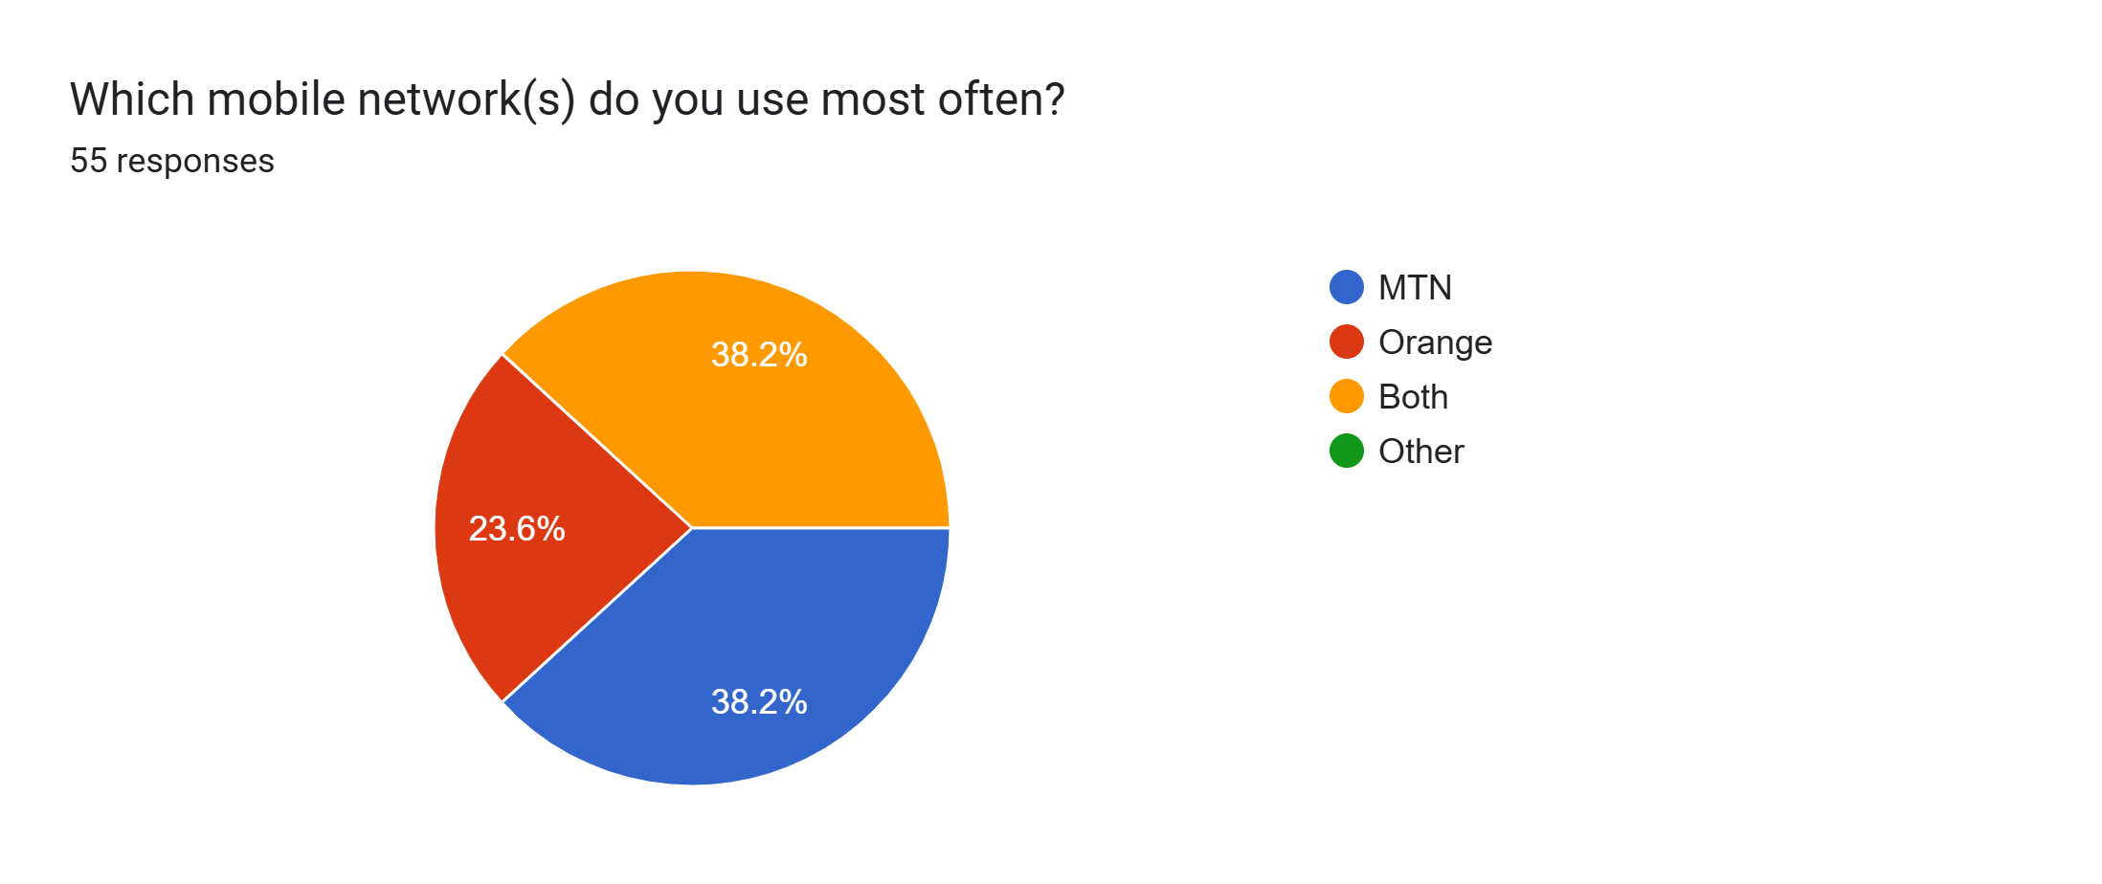
Question
Analysis
Provider Benchmarking: Identifies which local ISPs (MTN, Orange, Both, Others) require the most rigorous testing and optimization.
Infrastructure Correlation: Allows the system to map specific signal failures to the corresponding provider's tower density in that region.
Competitive Analysis: Establishes a baseline for Quality of Experience (QoE) comparisons across the different carriers used by stakeholders.
17
CEF440 Group 5 - University of Buea

Slide 19
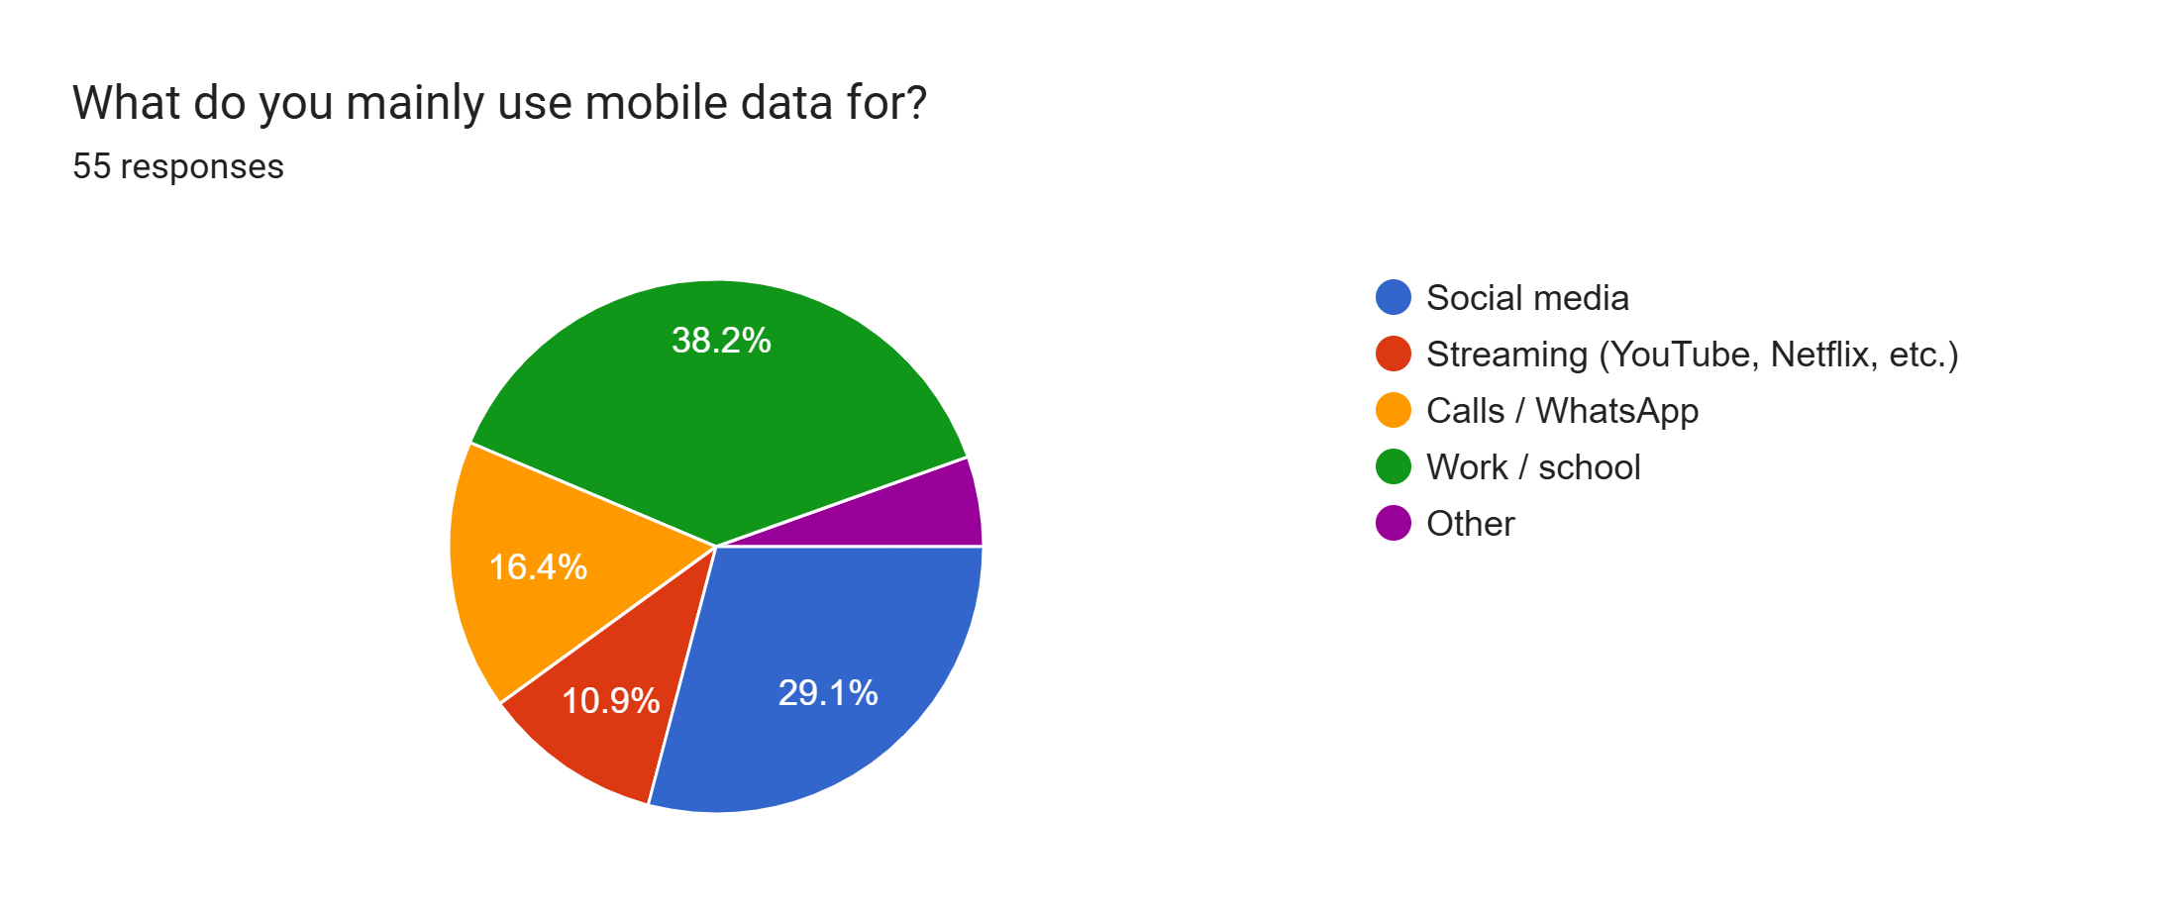
Question
Analysis
Identifies Usage Dominance: Pinpoints whether the network is being used for high-bandwidth (Streaming) vs. low-bandwidth (WhatsApp) tasks.
Predicts Network Strain: High "Streaming" responses signal a need for high downlink throughput, while "Work/School" suggests a need for stability.
Segments User Expectations: Defines the "context of use," allowing you to weight the Overall Experience rating against the specific demands of these activities.
This question isn't just about habits; it's about defining which network bottlenecks will frustrate the user first and for easy detection.
17
CEF440 Group 5 - University of Buea

Slide 20
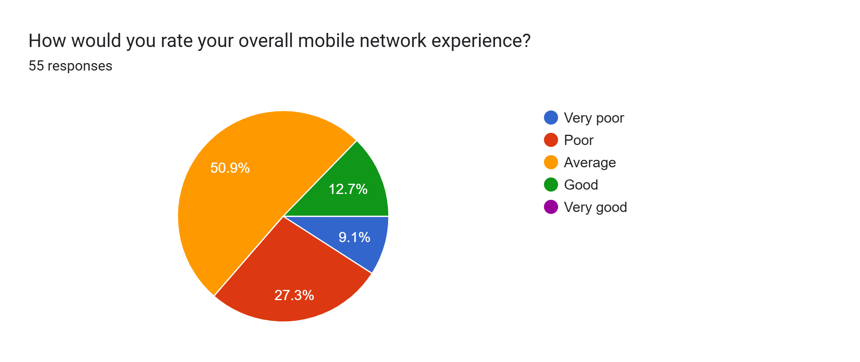
Question
Analysis
Identifies a Consistency Gap: A 50% "Average" rating suggests the network is functional but unreliable, failing to deliver the seamless experience required for high-demand tasks.
Signals Technical Stagnation: This "middle-of-the-road" sentiment often points to congestion or high latency during peak usage, even if raw signal strength is adequate.
Defines the Optimization Goal: For your implementation, this represents a massive opportunity to move the needle from "fine" to "excellent" through smarter data handling and latency reduction.
17
CEF440 Group 5 - University of Buea

Slide 21
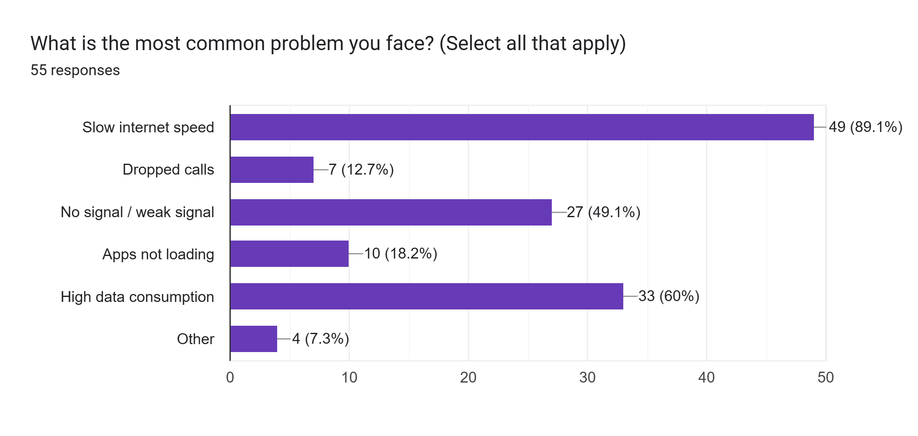
Question
Analysis
Critical Pain Point Analysis
Dominant Bottleneck: With 89.1% reporting slow speeds, this is a systemic throughput issue, not an isolated user error.
Infrastructure over Instance: The high percentage suggests that network congestion or throttling—likely during peak hours for "Streaming" and "Work"—is the primary driver of dissatisfaction.
Impact on Usability: This specific bottleneck directly compromises the Real-Time Interactive and High-Bandwidth needs identified in your earlier usage data.
When nearly 9 out of 10 users cite speed as their main issue, we are looking at a clear gap between user ambition and network capacity. This validates our 50% 'Average' experience rating from the previous slide.
17
CEF440 Group 5 - University of Buea

Slide 22
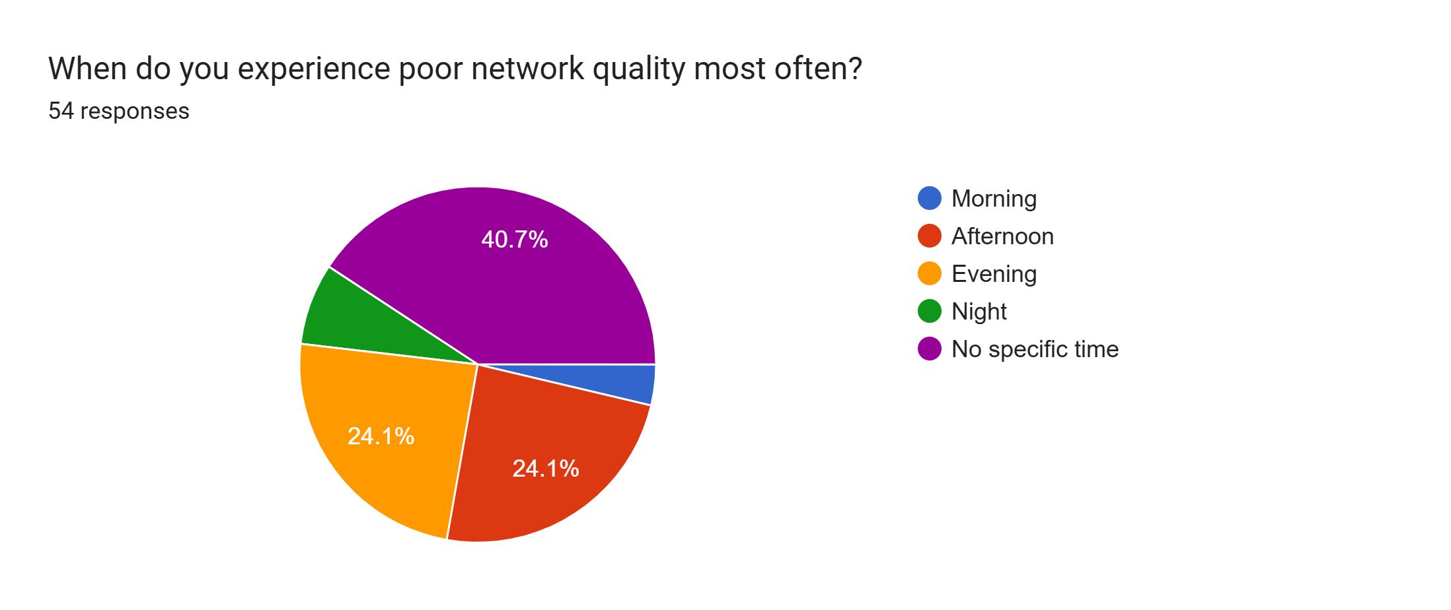
Question
Analysis
Continuous Monitoring Need: Since 40.7% report "No specific time," we must implement background passive testing rather than just scheduled checks.
17
CEF440 Group 5 - University of Buea

Slide 23
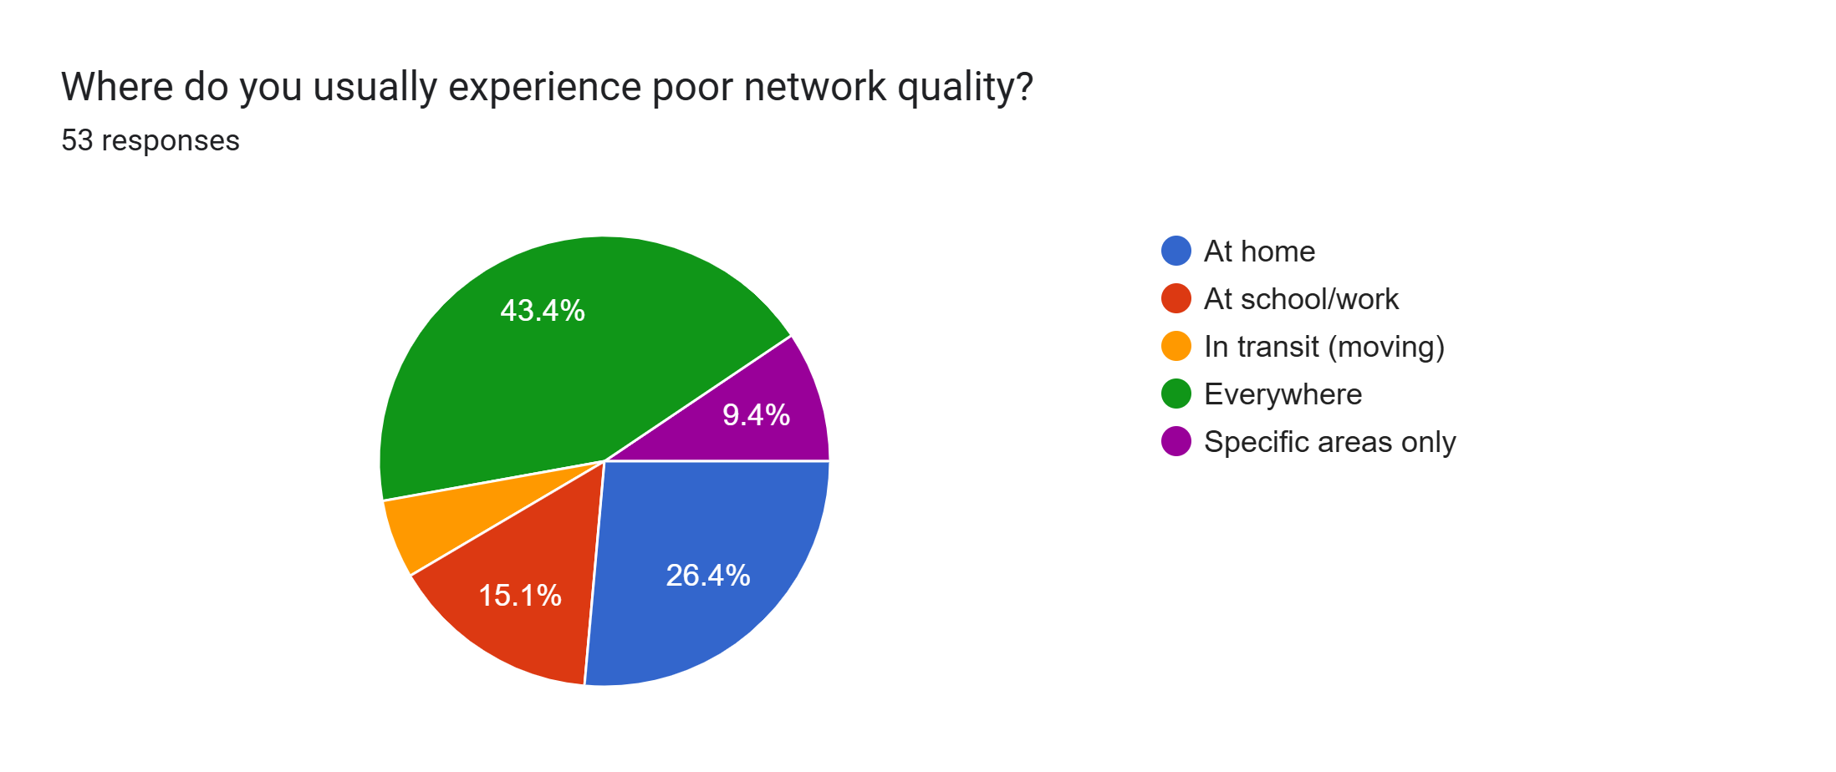
Question
Analysis
Systemic Failure: 43.4% of users report poor quality "Everywhere," indicating widespread network instability rather than isolated dead zones.
Fixed Location Struggles: 41.5% experience issues primarily at Home (26.4%) or School/Work (15.1%), suggesting poor indoor penetration or localized congestion.
Transit Stability: A small minority reported issues only while moving, confirming that the problem is rooted in stationary coverage.
Since most people have trouble "Everywhere" or at "Home," our app must include GPS tracking and signal recording to map exactly where the network is failing And To capture real-time feelings when these failures happen, the app must also trigger instant QoE pop-ups the moment a signal drop or "dead zone" is detected.
17
CEF440 Group 5 - University of Buea

Slide 24
Network Experience Data And Analysis
Users report frequent poor network conditions including slow download/upload speeds, weak signal strength, and intermittent connectivity. These issues persist across different locations and times of day, highlighting the need for comprehensive monitoring.
Continuous monitoring of key metrics is essential: latency, jitter, packet loss, and signal strength. Objective measurements must be complemented by subjective user feedback to capture the complete Quality of Experience picture.
5
University of Buea
CEF440 – Internet and Mobile Programming

Slide 25
User Interaction and Feedback Preferences
6
University of Buea
CEF440 – Internet and Mobile Programming

Slide 26
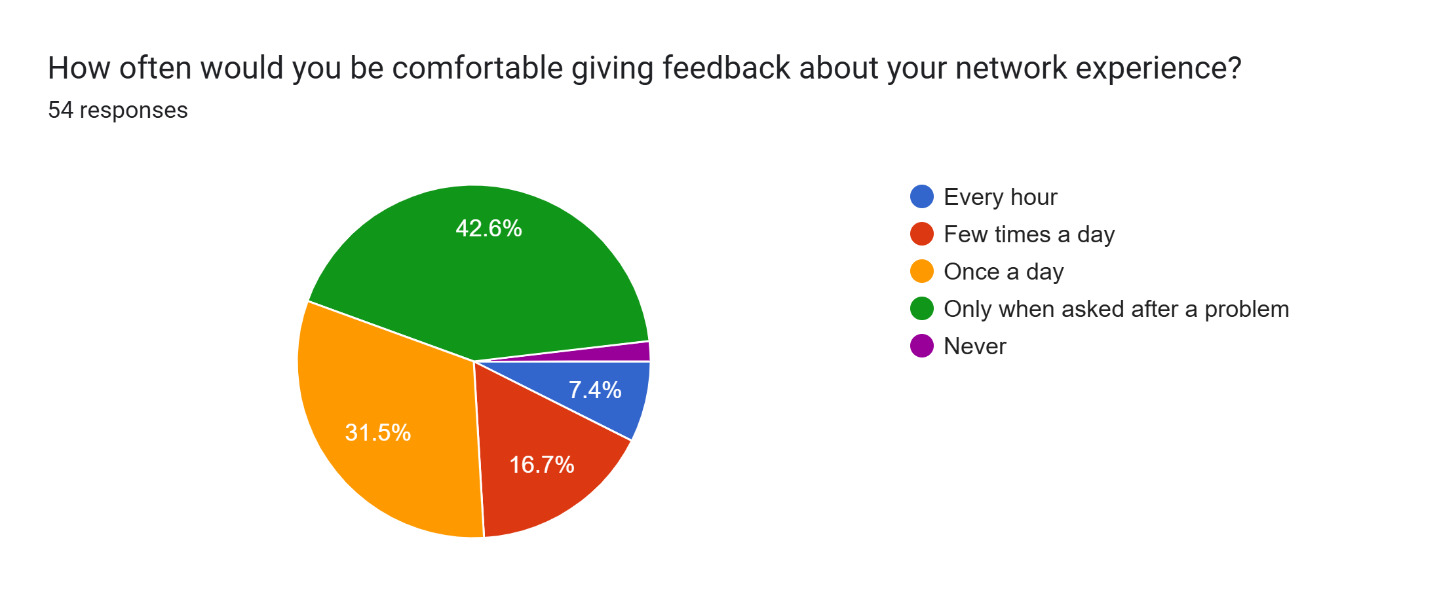
Question
Analysis
The survey shows that 42.6% of users only want to give feedback after a problem occurs, meaning the app must include event-triggered surveys that only appear when a network failure is detected.
17
CEF440 Group 5 - University of Buea

Slide 27
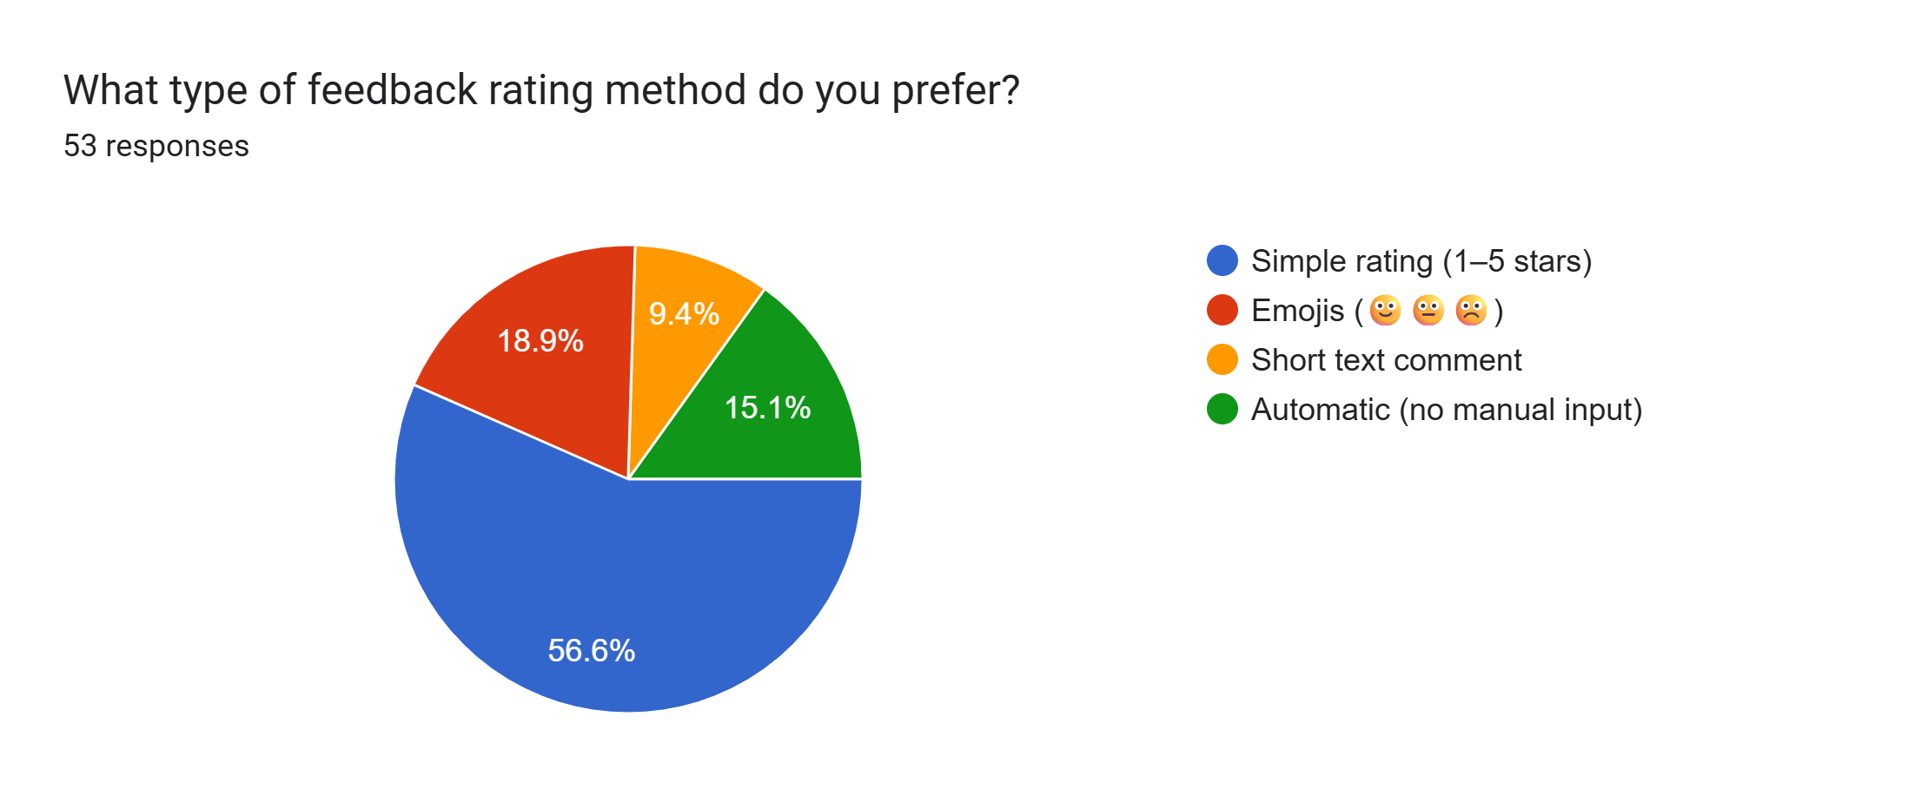
Question
Analysis
Since 56.6% of users prefer a simple 1-5 star rating, the app must include a quick star-based interface to ensure high response rates while minimizing user effort.
17
CEF440 Group 5 - University of Buea

Slide 28
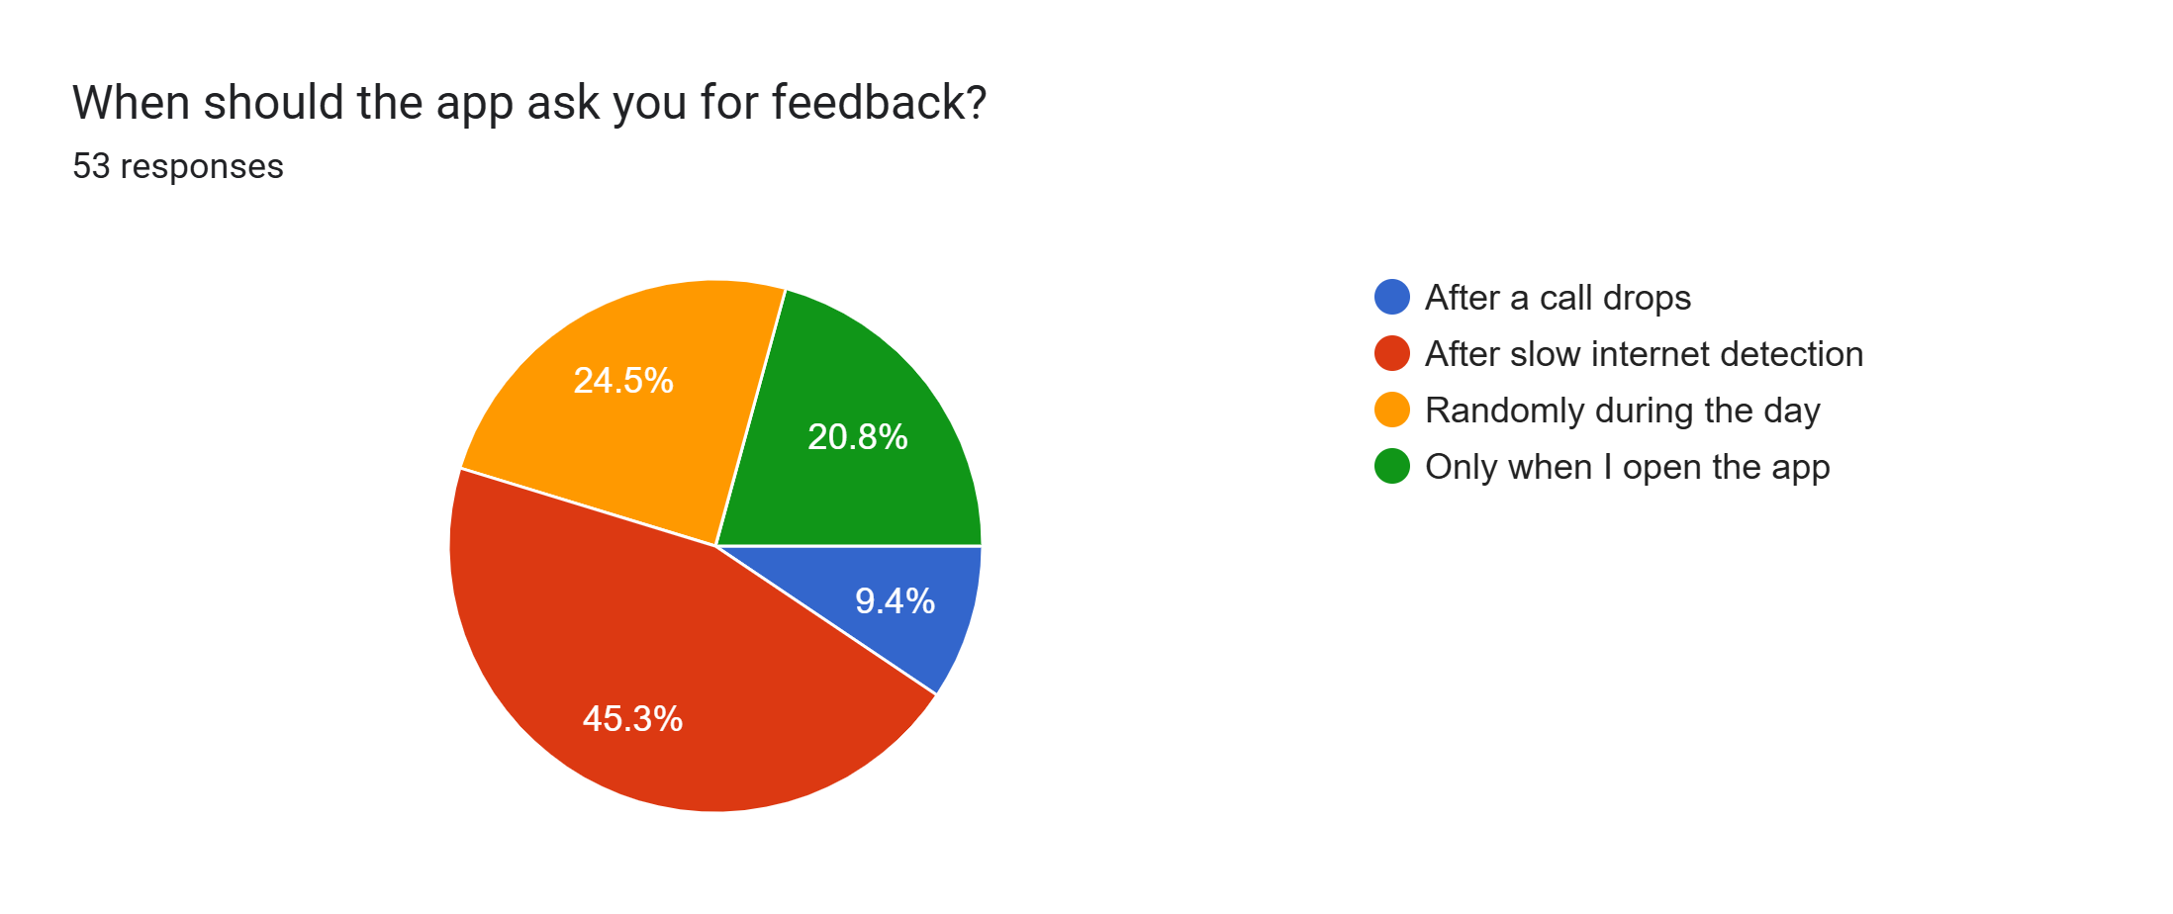
Question
Analysis
With 45.3% of users wanting to be asked after slow internet is detected, the app must include real-time speed monitoring that triggers a feedback prompt the moment throughput drops below a set threshold.
17
CEF440 Group 5 - University of Buea

Slide 29
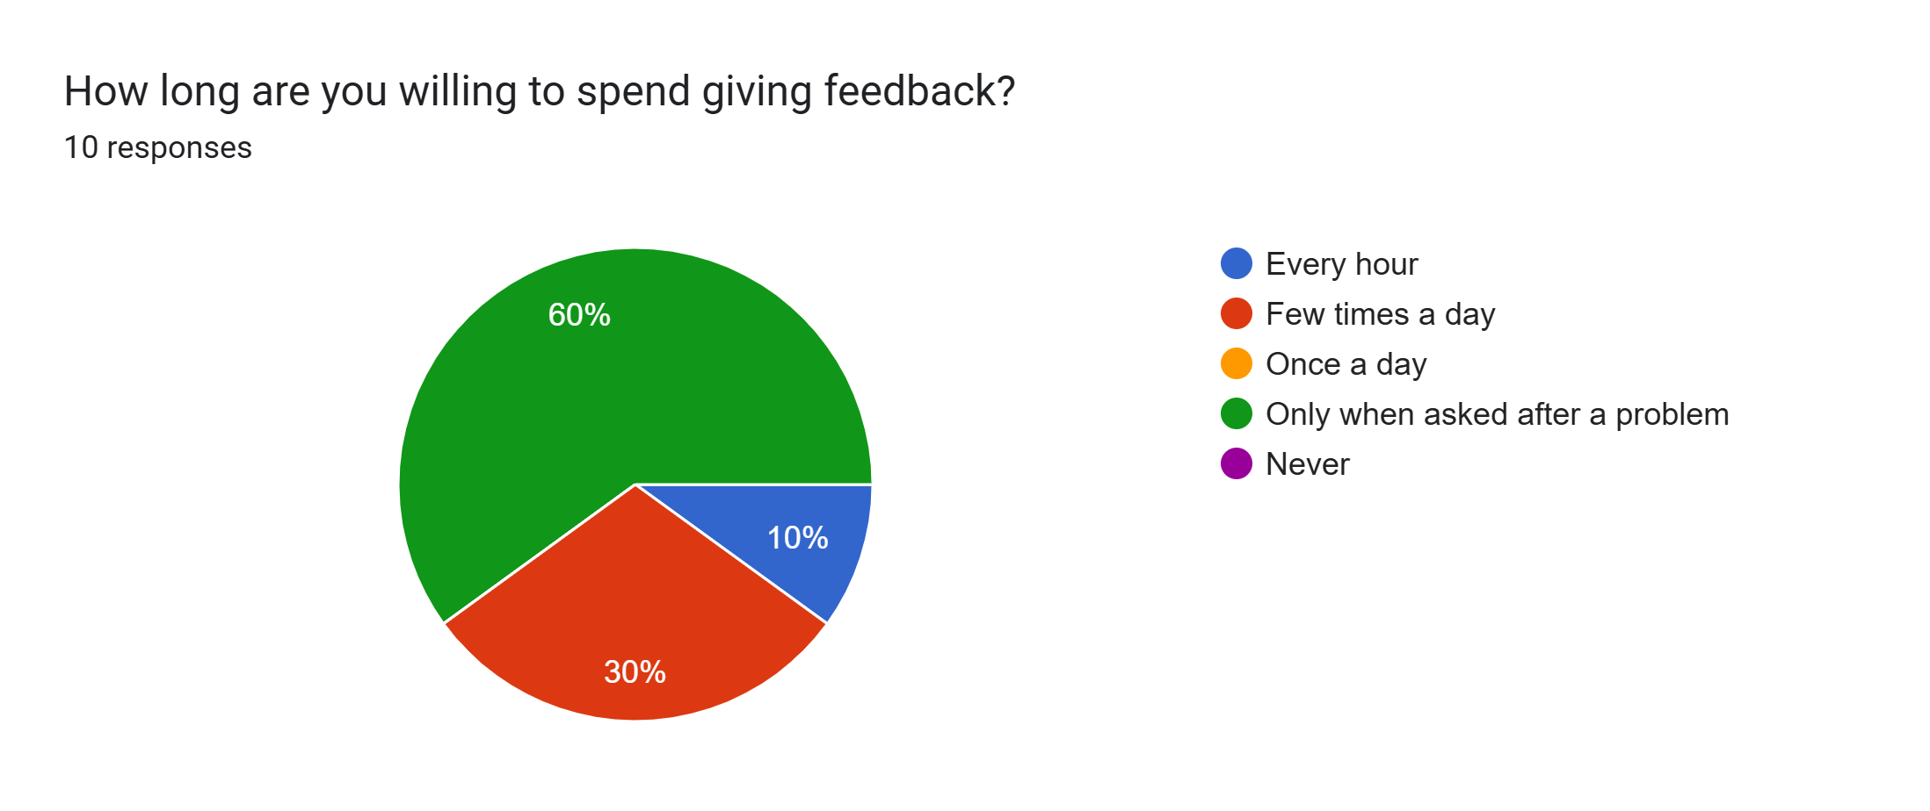
Question
55
Analysis
The majority of users prefer a reactive approach, meaning they are most likely to provide feedback only when something goes wrong and they are prompted rather than a regular or fixed approach.
17
CEF440 Group 5 - University of Buea

Slide 30
User Interaction and Feedback Preferences
Users prefer minimal, non-intrusive interaction when providing feedback. Rating scales and emoji-based responses are favored, with most willing to spend less than 10 seconds on feedback submission.
Key requirements include fast, intuitive interfaces and context-aware feedback triggers that activate intelligently after network issues occur, ensuring timely and relevant user input collection.
6
University of Buea
CEF440 – Internet and Mobile Programming

Slide 31
Privacy And Trust Analysis
7
University of Buea
CEF440 – Group 5

Slide 32
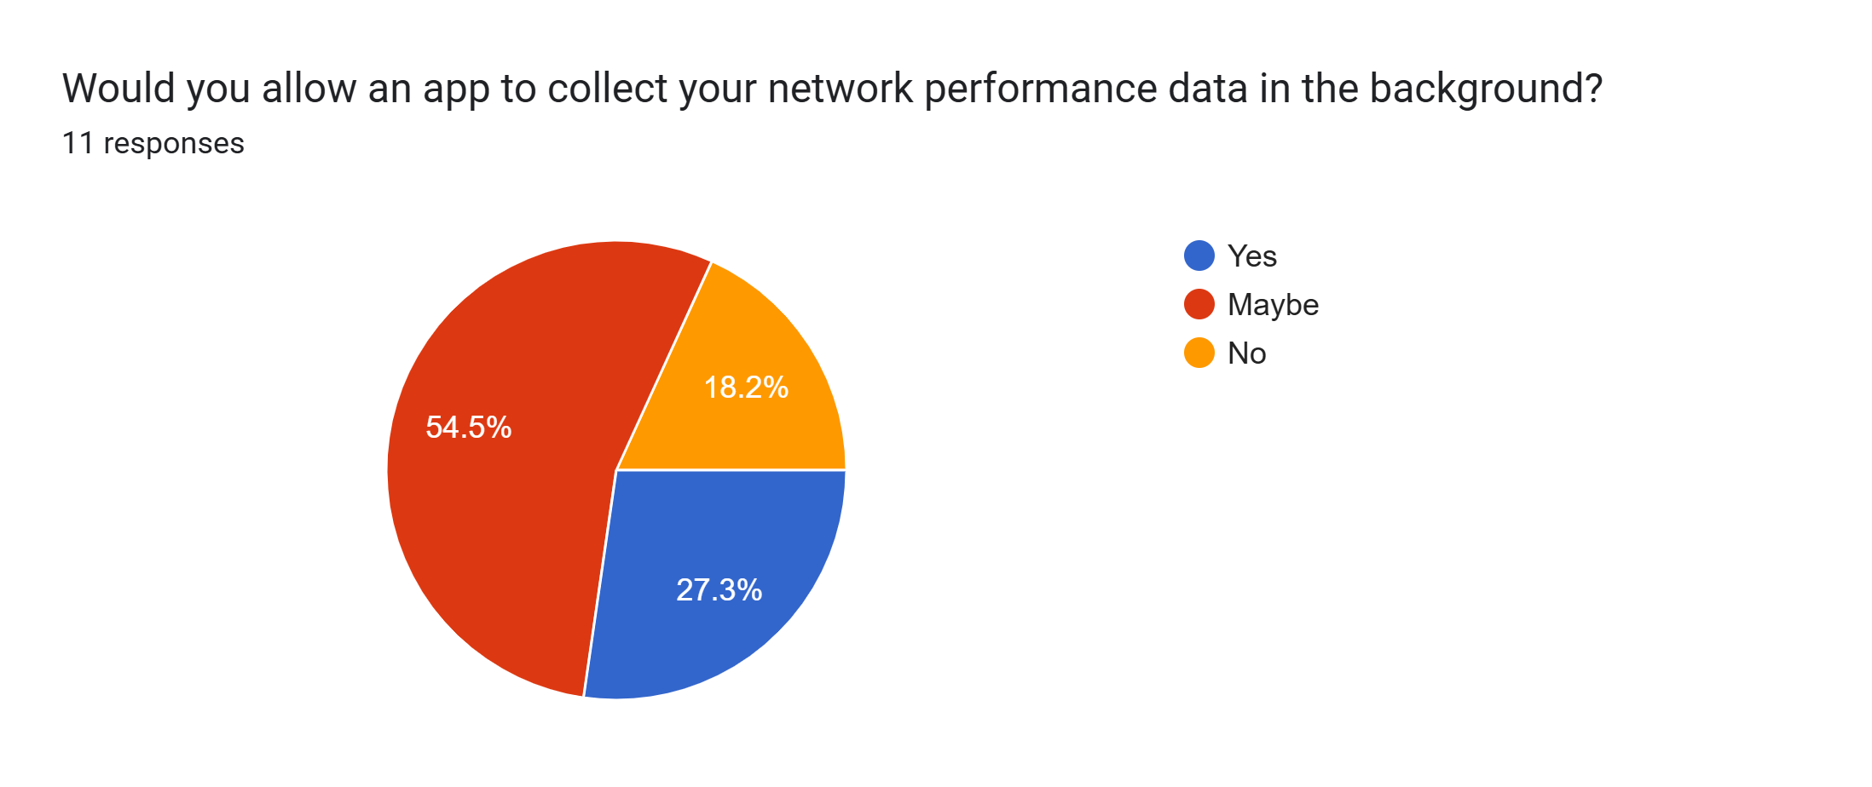
Question
Analysis
With 54.5% of users saying "Maybe" and 27.3% saying "Yes," the app must include a clear privacy toggle and an explanation of data benefits to secure user trust for background collection.
17
CEF440 Group 5 - University of Buea

Slide 33
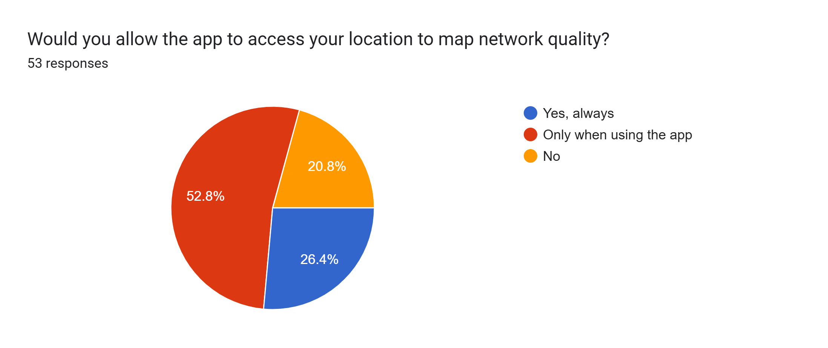
Question
Analysis
With 52.8% of users only allowing location access "Only when using the app," the platform must include a real-time tracking mode that activates during manual speed tests to ensure location data is captured.
17
CEF440 Group 5 - University of Buea

Slide 34
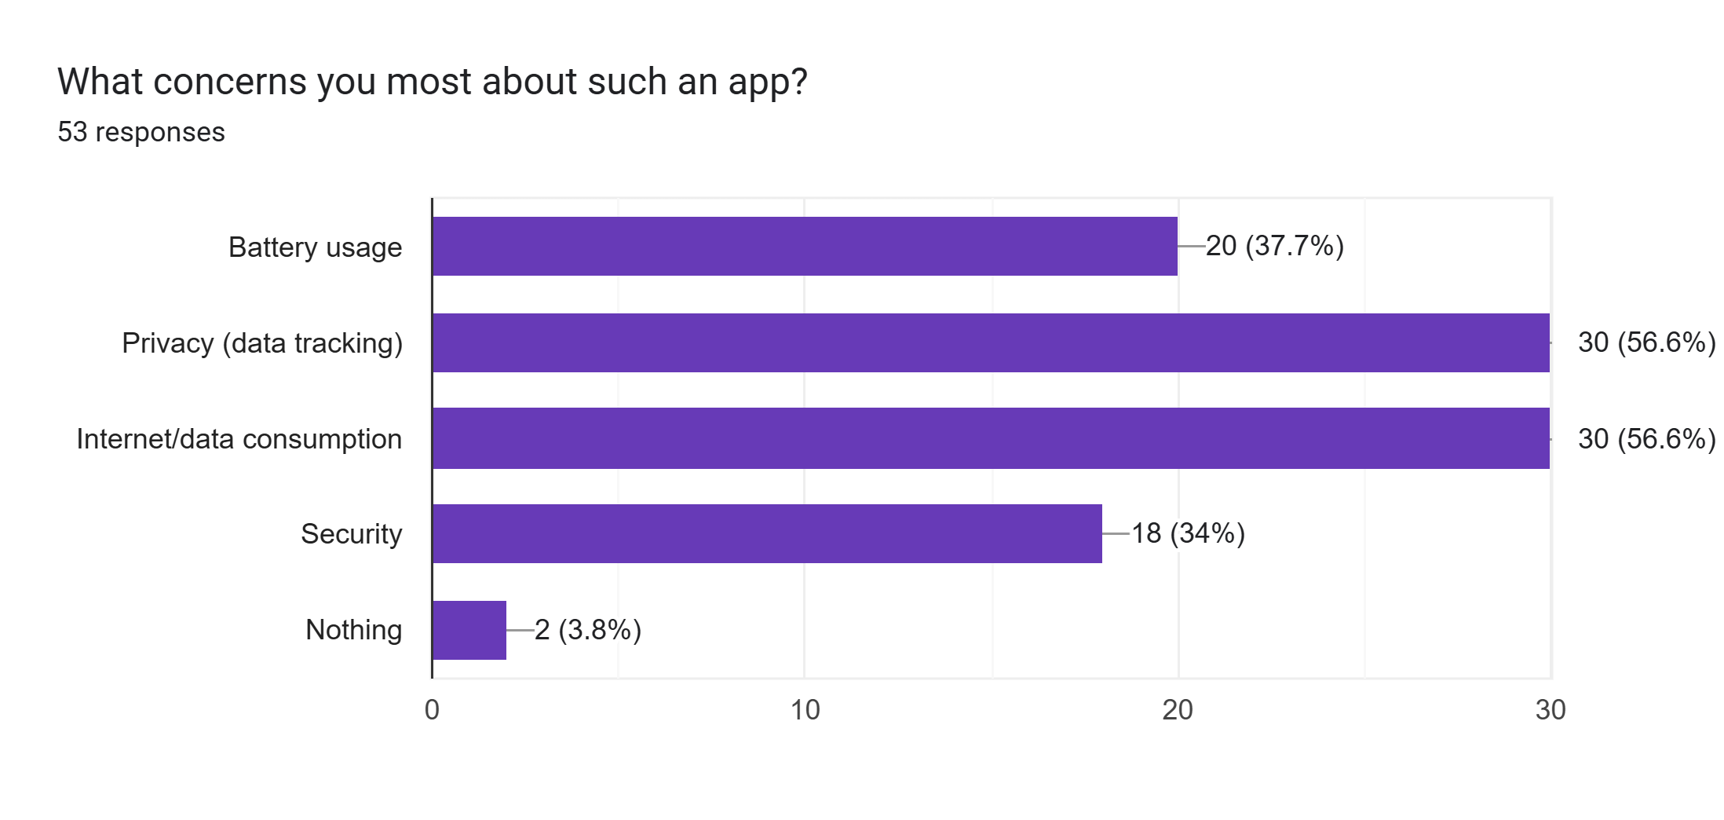
Question
Analysis
Because 56.6% of users prioritize privacy and 37.7% worry about battery, the app must include robust data encryption and a low-energy background mode to address these primary adoption barriers.
17
CEF440 Group 5 - University of Buea

Slide 35
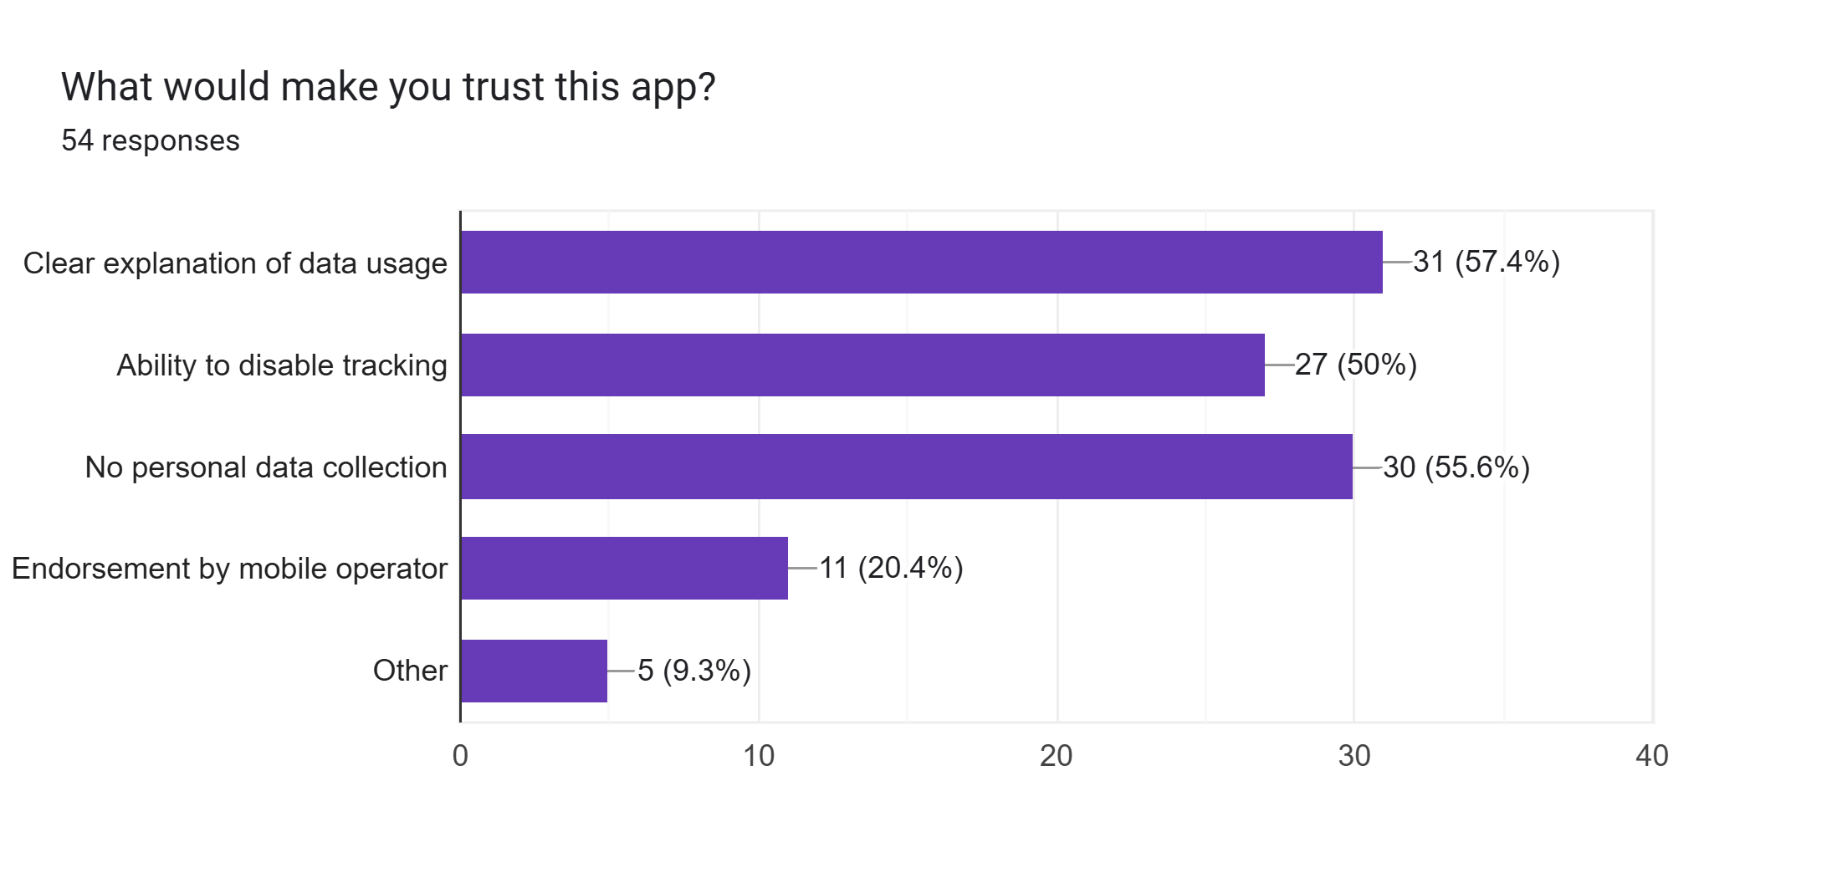
Question
Analysis
Since 57.4% of users demand a clear explanation and 50% want the ability to disable tracking, the app must include a transparent data policy and a one-tap kill switch to build and maintain user trust.
17
CEF440 Group 5 - University of Buea

Slide 36
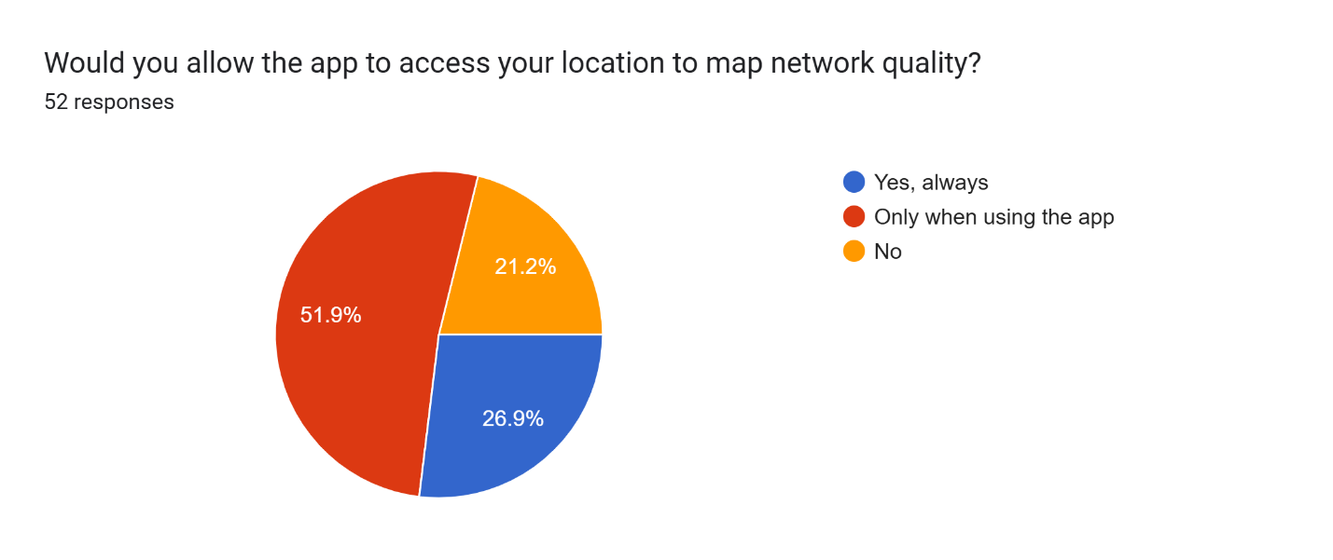
Question
Analysis
The survey shows that 42.6% of users only want to give feedback after a problem occurs, meaning the app must include event-triggered surveys that only appear when a network failure is detected.
17
CEF440 Group 5 - University of Buea

Slide 37
Privacy and Trust Analysis
Privacy concerns strongly affect app acceptance. Users express conditional consent for background data collection only when processes are transparent and controllable. Major concerns include location tracking and background activity monitoring.
Required measures: data anonymization, minimal data collection, clear communication about usage, explicit commitment to no access to personal information, and user-controlled permission settings. Trust is built through transparency.
7
University of Buea
CEF440 – Group 5

Slide 38
User Motivation and Adoption Factors
9
University of Buea
CEF440 – Group 5

Slide 39
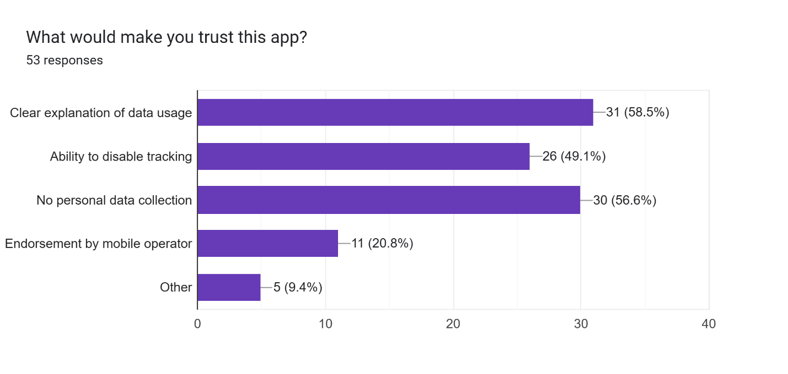
Question
Analysis
Because 58.5% of users demand a clear explanation and 49.1% want control, the app must include a transparent privacy policy and an easy-to-use tracking toggle to build user trust.
17
CEF440 Group 5 - University of Buea

Slide 40
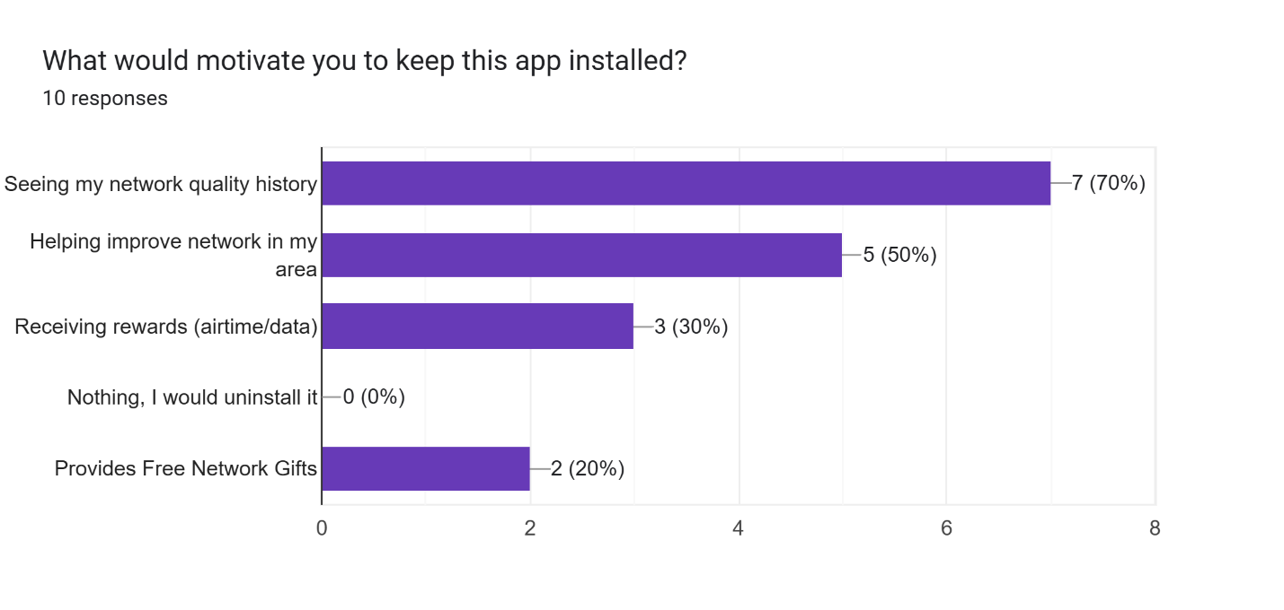
Question
Analysis
Since 70% of users are motivated by seeing their own performance data, the app must include a personal network quality history dashboard to drive long-term retention.
17
CEF440 Group 5 - University of Buea

Slide 41
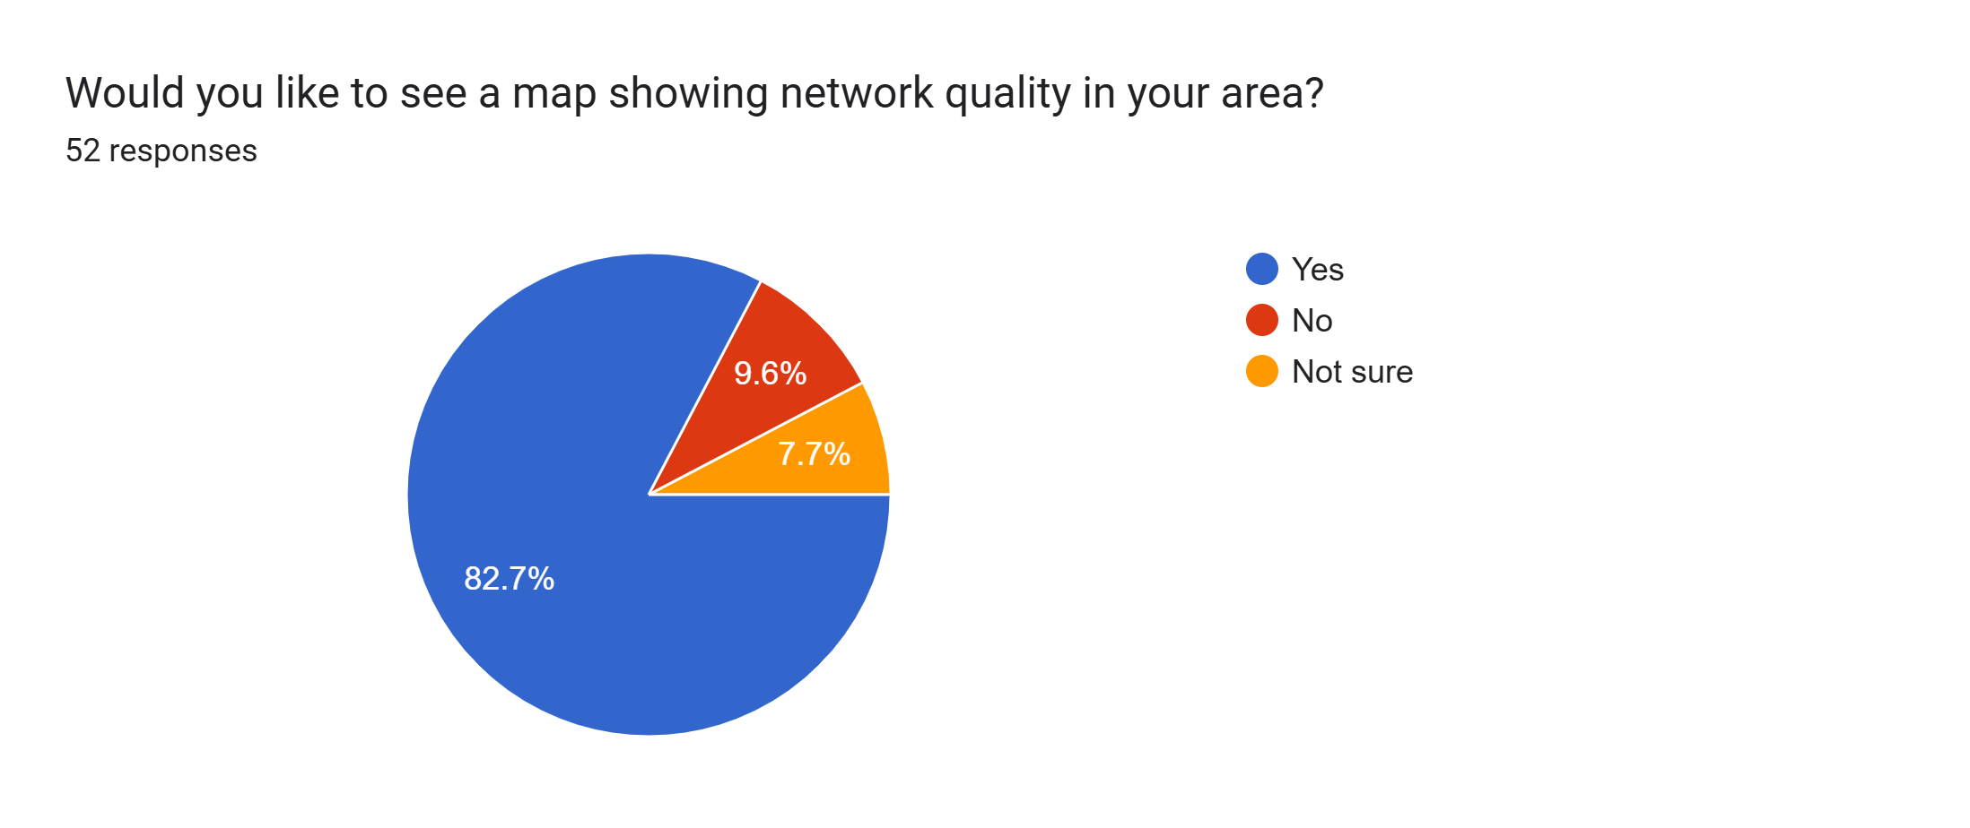
Question
Analysis
With 82.4% of users wanting to see local network conditions, the app must include a real-time coverage heatmap to provide immediate value and transparency to the community.
17
CEF440 Group 5 - University of Buea

Slide 42
User Motivation and Adoption Factors
Retention depends on providing tangible benefits to users. Key motivators include access to personal network insights, visibility into their own connectivity performance, and the sense of contributing to broader network improvements in Cameroon.
Suggested user-facing features to drive engagement include simple dashboards displaying network quality metrics, performance summaries over time, and easy-to-understand visualizations that help users see the value of their participation.
9
University of Buea
CEF440 – Group 5

Slide 43
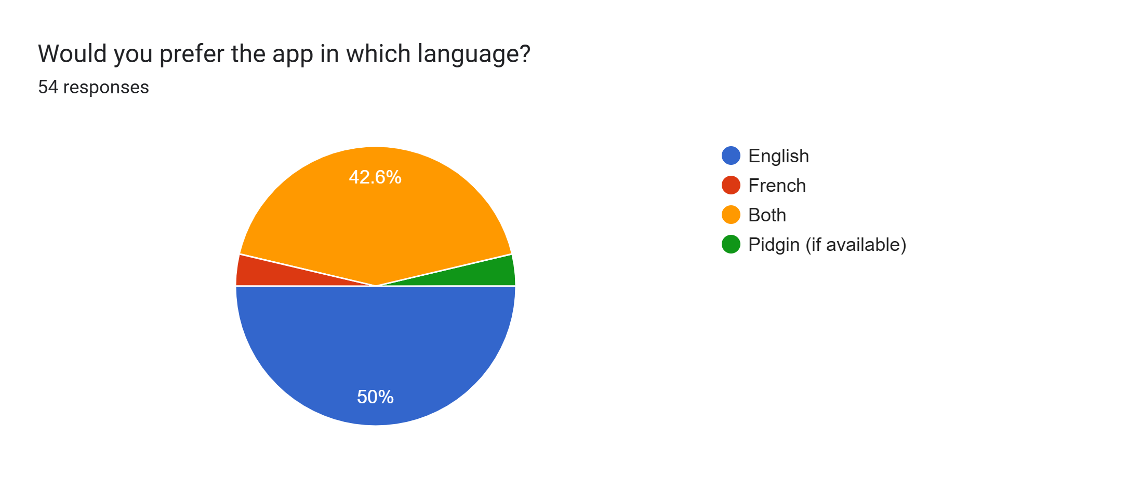
Question
What Language should the app use?
Analysis
Since 92.6% of users require either English or a bilingual experience, the app must include a multi-language toggle supporting English and French to ensure full accessibility.
17
CEF440 Group 5 - University of Buea

Slide 44
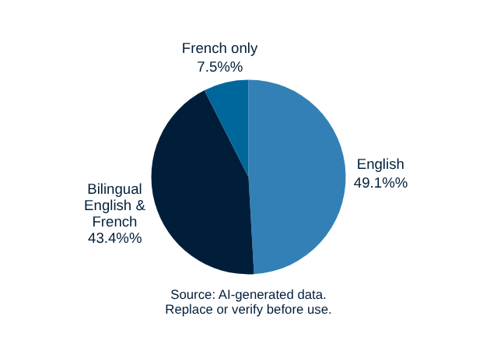
Language and Localisation Preferences
Our survey reveals clear language preferences among mobile subscribers. Nearly half (49.1%) prefer English as their primary interface language, while 43.4% favor a bilingual English and French option. A smaller group prefers French only. For the Central African context, the app will default to English with an easy option to switch to French, ensuring accessibility for all users in Cameroon.
10
University of Buea
CEF440 – Group 5

Slide 45
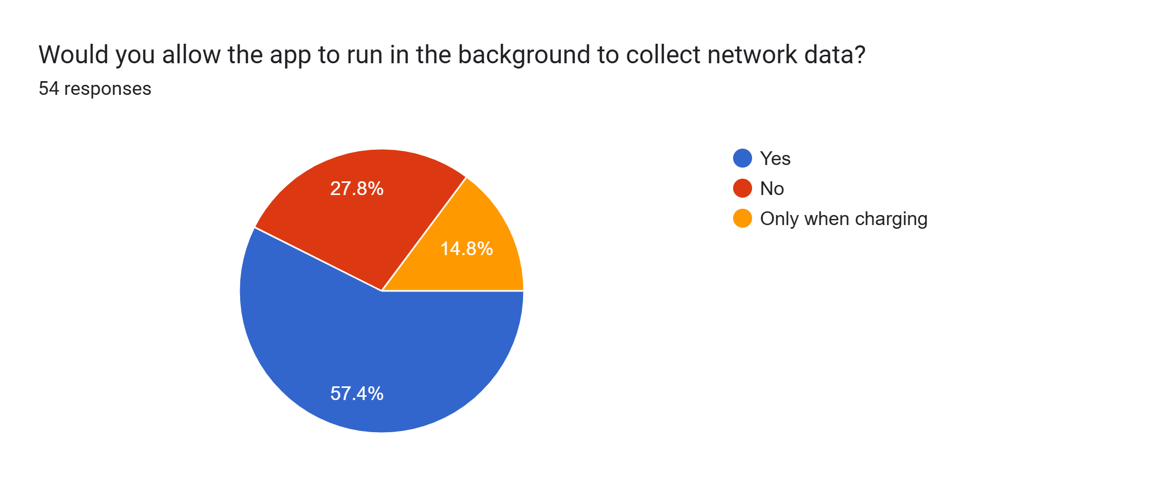
Question
Analysis
Since 57.4% of users are willing to allow background data collection (including those who prefer it "Only when charging"), the app must include a background execution toggle with a specific "Charge-Only" mode to maximize data gathering while respecting user preferences.
17
CEF440 Group 5 - University of Buea

Slide 46
General Analysis
17
CEF440 Group 5 - University of Buea

Slide 47
SYSTEM CONSTRAINTS
D
Device & Battery Limitations
Battery sensitivity: Users highly aware of apps draining power
Low-end devices: Limited RAM, storage, and processing capabilities common in target market
Background activity must be minimized to preserve battery life
Energy-efficient algorithms required for continuous monitoring
D
Design Requirements
Offline-first storage: Cache data locally during connectivity gaps
Adaptive syncing: Upload data only when conditions are favorable
Minimal background processes to reduce resource consumption
Graceful degradation on unstable networks
Lightweight data formats to reduce transmission costs
8
University of Buea
CEF440 - Group 5

Slide 48
TECHNOLOGY ANALYSIS
Python & Go
Python: Rapid development, extensive libraries for data processing and analysis
Go: Excellent for high concurrency, efficient for backend services
Critical: Backend handles data aggregation and storage
C/C++ & Rust
C/C++: High precision for network measurements, but complex memory management
Rust: Performance and memory safety, steep learning curve
Critical: Mobile device performs actual network measurements
11
University of Buea
CEF440 – Group 5

Slide 49
Technology Selection and System Architecture
Our system employs a client-server architecture designed for cross-platform compatibility and scalability. The frontend utilizes React Native with Expo, enabling a single codebase for both Android and iOS platforms while maintaining native performance. For performance-critical network measurements, we integrate native modules written in Kotlin (Android) and Swift (iOS) to ensure accurate QoE data collection. The backend leverages Node.js with Express, providing a lightweight, event-driven framework for scalable RESTful APIs capable of real-time data ingestion. This architecture ensures efficient communication between the mobile client and server while supporting the high-concurrency demands of collecting user experience data from numerous subscribers.
12
University of Buea
CEF440 – Group 5

Slide 50
Frontend Design Details
The mobile application leverages React Native with Expo to maintain a single codebase for both Android and iOS platforms, significantly reducing development time and ensuring consistent user experience. For performance-critical network measurements requiring direct hardware access, native modules are implemented in Kotlin (Android) and Swift (iOS). On Android, WorkManager handles background task scheduling for continuous data collection, while Room provides robust local database storage. The architecture follows an offline-first approach, storing collected QoE data locally and synchronizing with the backend when connectivity is available, ensuring no data loss during network disruptions.
13
University of Buea
CEF440 – Group 5

Slide 51
Backend Design Details
The backend infrastructure leverages Node.js with Express framework, providing a lightweight, event-driven architecture ideal for handling RESTful APIs. This stack efficiently manages receiving, validating, and processing QoE/QoS data submitted by mobile clients. MongoDB serves as the primary database, offering horizontal scalability and flexible schema design for diverse telemetry data. Importantly, the backend does NOT perform network speed tests—these measurements are conducted exclusively on the client device to ensure accuracy. The server focuses on data aggregation, storage, and providing endpoints for dashboard analytics.
14
University of Buea
CEF440 – Group 5

Slide 52
Security and Privacy Measures
HTTPS Encryption: All data transmission between the mobile app and backend servers uses secure HTTPS protocols, ensuring end-to-end encryption and protection against interception or man-in-the-middle attacks.
Data Anonymization: User identities are protected through anonymization techniques. Personal identifiers are stripped from collected QoE data, with strict permission handling and transparent communication about data usage and user controls.
15
University of Buea
CEF440 – Group 5

Slide 53
Conclusion
Our requirements analysis has yielded a balanced technology stack that aligns with user needs and technical constraints. The client-server architecture supports accurate QoE/QoS data collection while ensuring performance and scalability for network operators in Cameroon. Our user-centric design approach addresses critical concerns including privacy transparency, intuitive usability, and long-term motivation through tangible benefits. With React Native for cross-platform development, native modules for precise measurements, and a robust Node.js backend, we have established a solid foundation for successful system implementation that will bridge the gap between objective network metrics and real user experience feedback.
16
University of Buea
CEF440 – Group 5

Slide 54
Thank You
For Your Attention
17
CEF440 Group 5 - University of Buea
GitHub: github.com/BrayanMorningstar237/CEF440_Group5

